Slide 1


Analyzing NYC Airbnb Open Data
Data Science 2024 Bootcamp
Shihui Feng, Antong Lei

Slide 2

Table of Contents
1.
Introduction
2.
Goal & Hypothesis
3.
Our Process of dataset
4.
Data Visualization
5.
Model Selection
6.
Conclusion & Discussion

Slide 3
01
Introduction

Slide 4




Overview of the Project
The main idea of this project is to use the NYC Airbnb Open Data to conduct a comprehensive analysis that will yield actionable insights for both hosts and potential renters.
By delving into Airbnb's extensive dataset, we hope to uncover patterns, trends, and factors influencing rental prices and demand in New York City's dynamic accommodation market.

Slide 5


Company Background
Online platform that allows people to rent out their homes or spare rooms to guests looking for short-term lodging.
Founded in 2008, has rapidly transformed the hospitality industry by offering an alternative to traditional hotels.
The platform connects hosts and guests, providing a variety of accommodation options such as apartments, houses, and unique stays.
Importance of Airbnb in NYC:
Economic impact
Flexibility and affordability
Accommodation diversity
Neighborhood revitalization
Encouraging tourism beyond traditional tourist areas, benefiting local businesses and communities.
Cultural exchange

Slide 6
02
Goal & Hypothesis

Slide 7
Current Goal
Predicting rental prices based on relevant features.
Learn how to use area (locations) to predict apartment pricings
Goal

Slide 8
Hypothesis
The size of the location will increase with season —> Affecting Price
Price of Location —> Depends on Availability
More Review —> Less Availability
Holiday season rents will be more expensive due to high demand
The larger the apts size, the more pricey it is
On average Manhattan apts price will be more expensive than other boroughs
The central the neighborhood, the higher the apts price
The neighborhood with better public transportations have a higher price
The more reviews the apts has, the less availability apt will be
The cheaper the apt is for the location, the less availability apt has
The more listings(calculated_host_listings_count) the host has, the less availability it would be (due to experience)
The longer characters the airbnb name has, the more availability there is
Entire home/apt renting has less availability than private room

Slide 9
03
Our Process

Slide 10
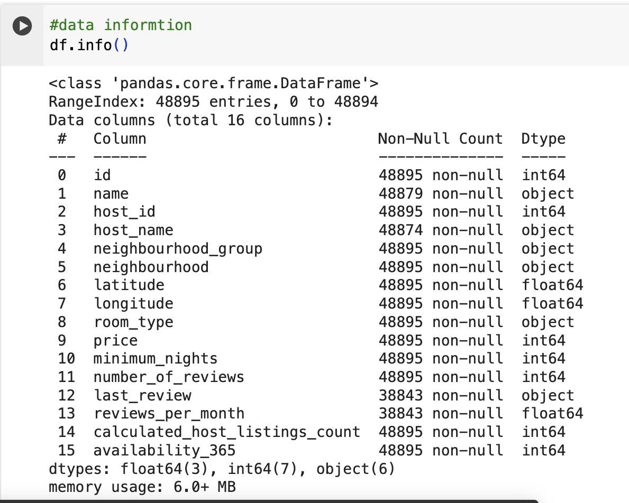
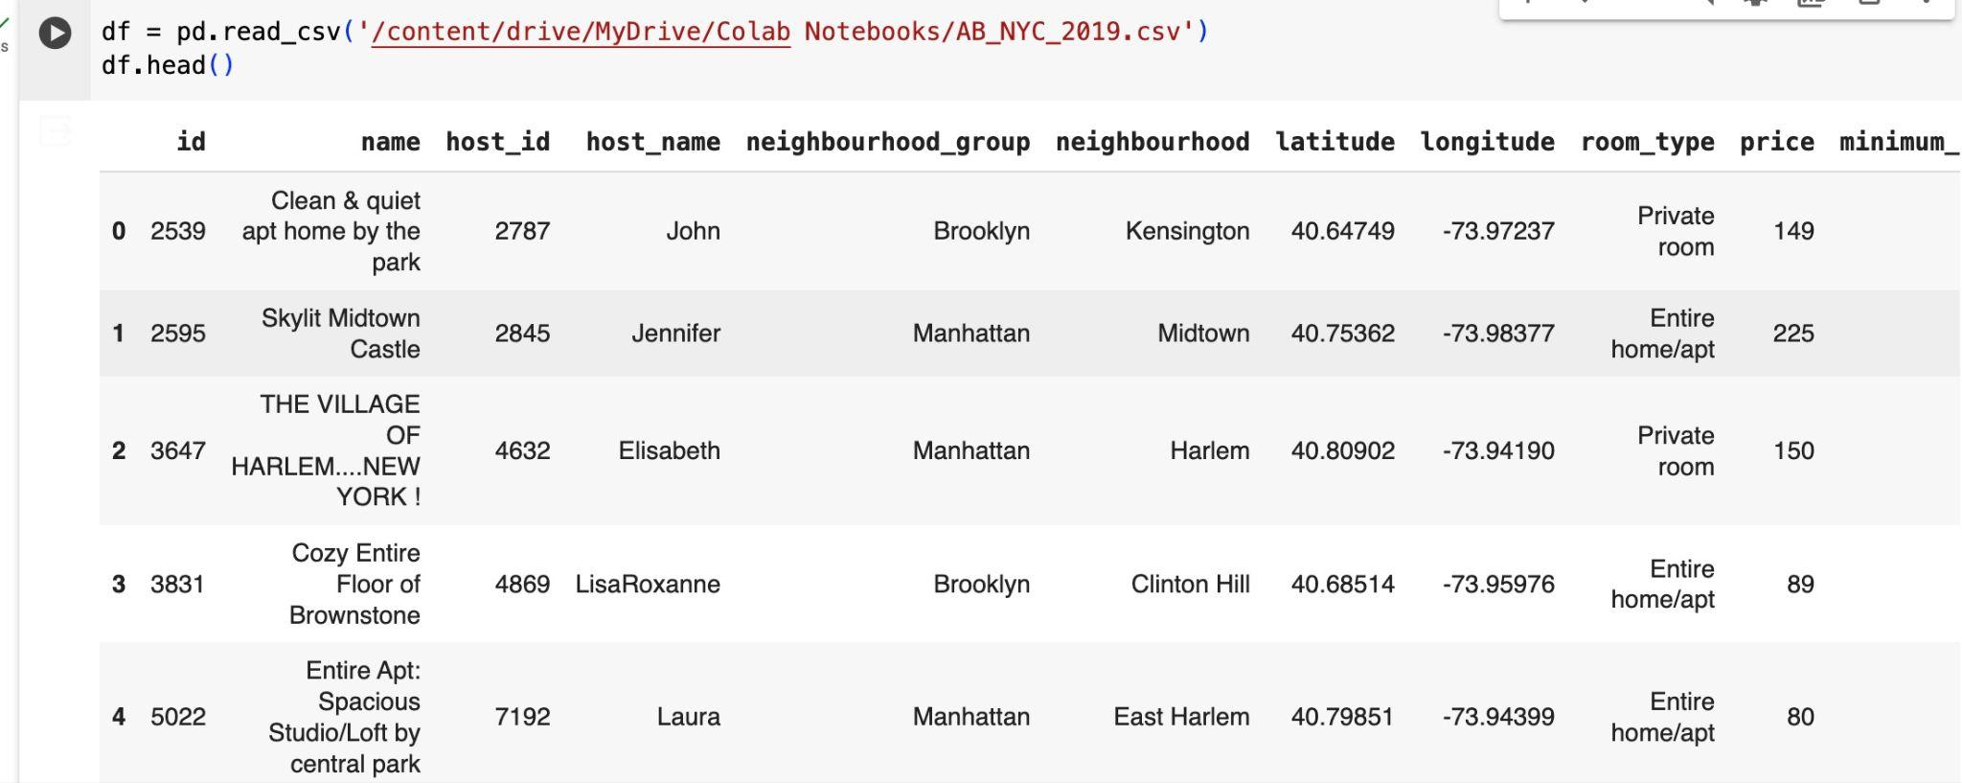
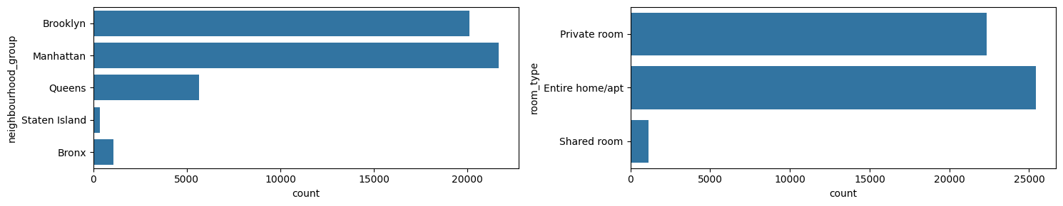

Slide 11
Overview of NYC Airbnb Dataset (Data Description)
Data Information
Acquired the NYC Airbnb dataset containing 48,895 entries and 16 columns.
Checked the shape and info of the DataFrame to understand its structure and dimensions.
Data begin at 2019
Delete Missing Data:
Identified missing data by generating a boolean DataFrame.
Summarized missing data by column.
Found rows with missing data and specifically targeted columns ('name' and 'host_name').
Replaced missing values:
Filled missing values in 'name' and 'host_name' with 'unknown'.
Imputed missing values in 'reviews_per_month' with 0.
Forward-filled missing values in 'last_review' column.
.

Slide 12
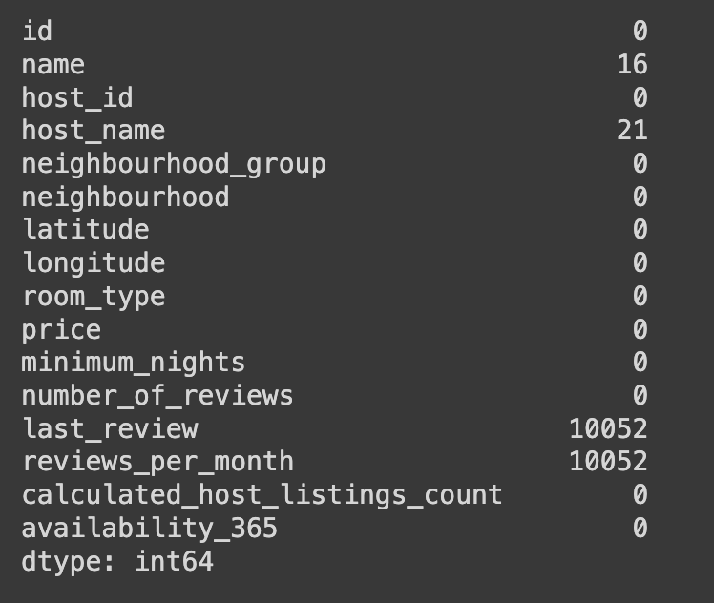
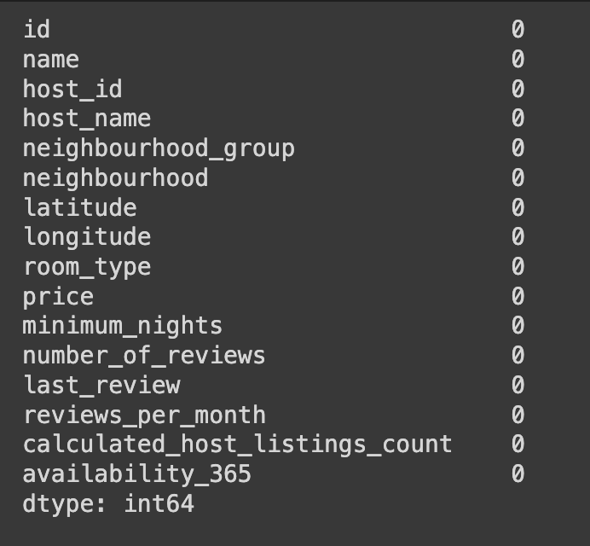

Slide 13
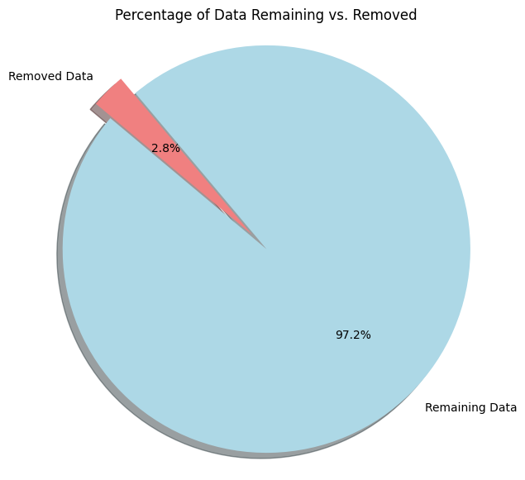
Distribution of features and identification of patterns
Removal:
Detected outliers in the 'price' column using the Interquartile Range (IQR) method.
Calculated lower and upper bounds for outlier detection.
Removed outliers falling outside the defined bounds.
Compared the original data size (48,895 rows) with the size after outlier removal.
Visualization:
Plotted a pie chart to illustrate the percentage of data remaining after outlier removal compared to the removed data.
Remaining Data- 97.2%
Removed Data - 2.8 %

Slide 14
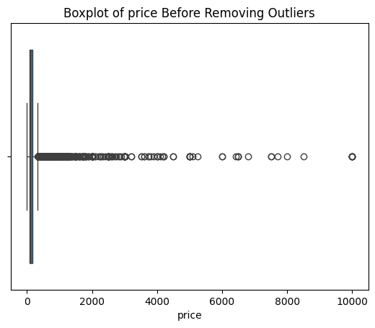
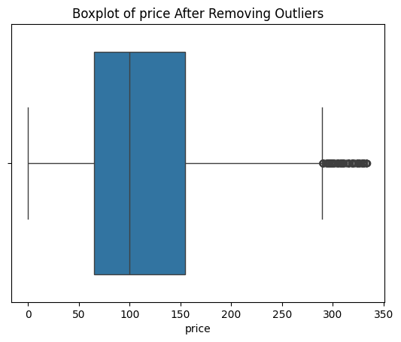
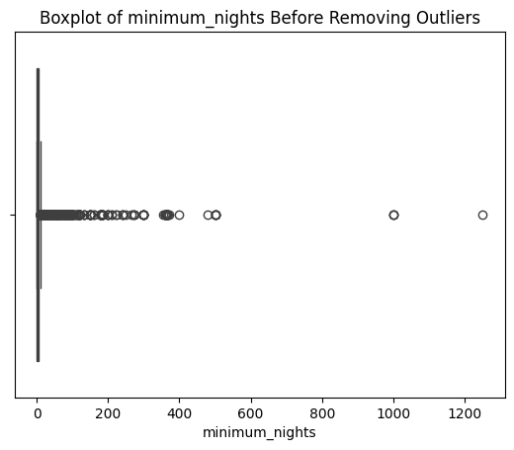
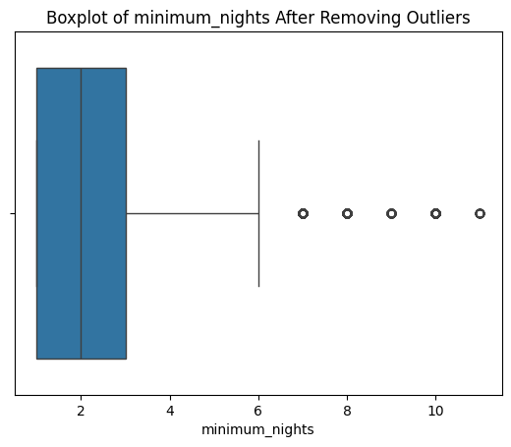

Slide 15
04
Data Visualization

Slide 16
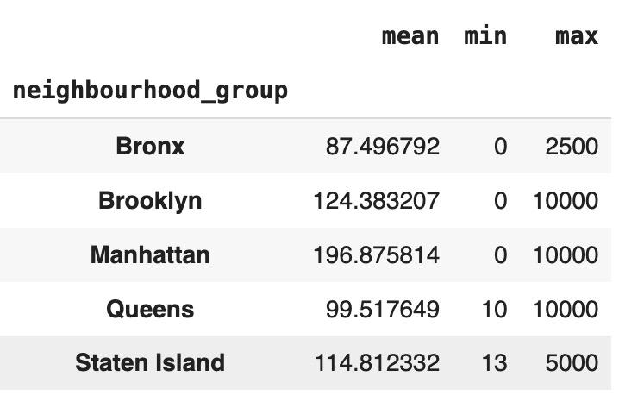

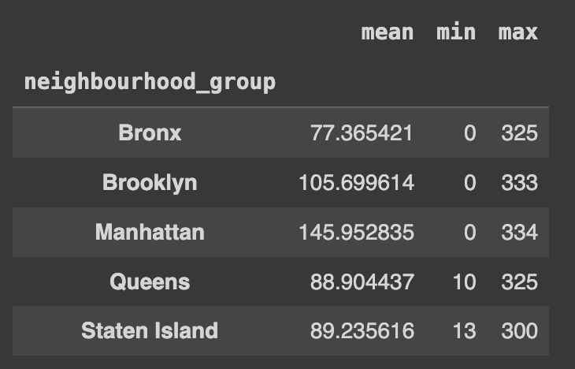
Find the Median price for each neighborhood
Median Price Analysis:
Get the median price per neighborhood group for every column.
Utilized groupby to calculate and display median prices per neighborhood group, both with and without outliers.

Slide 17
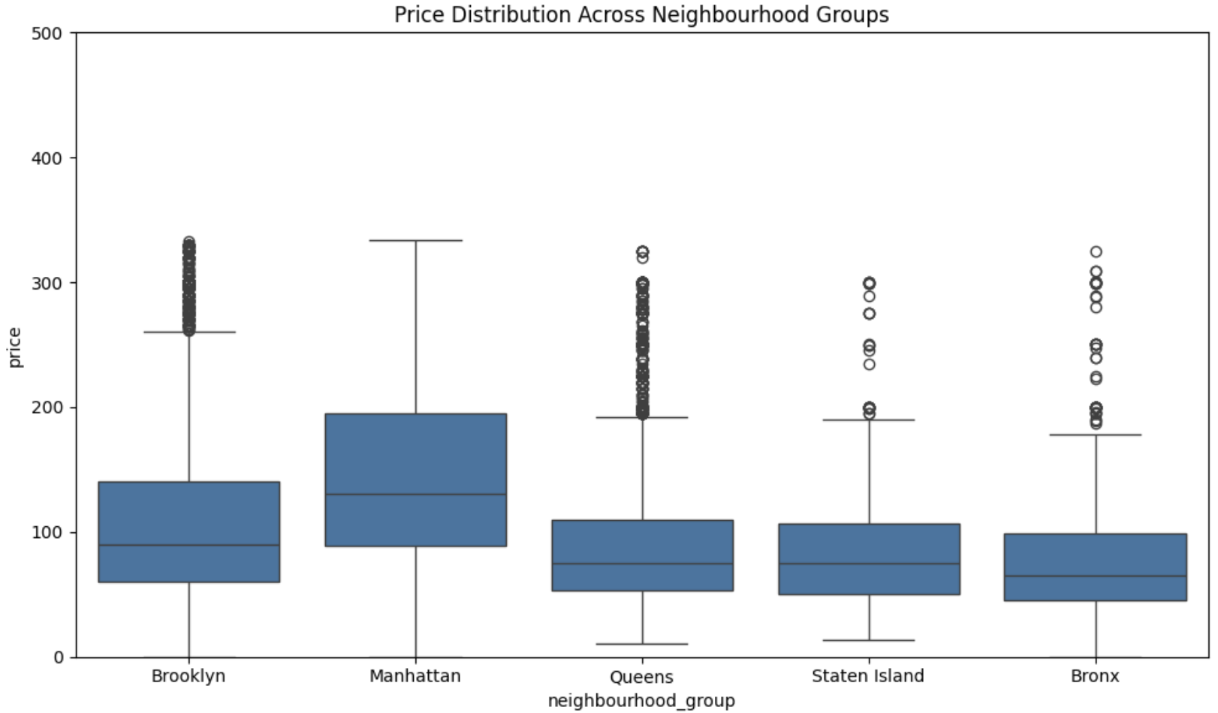
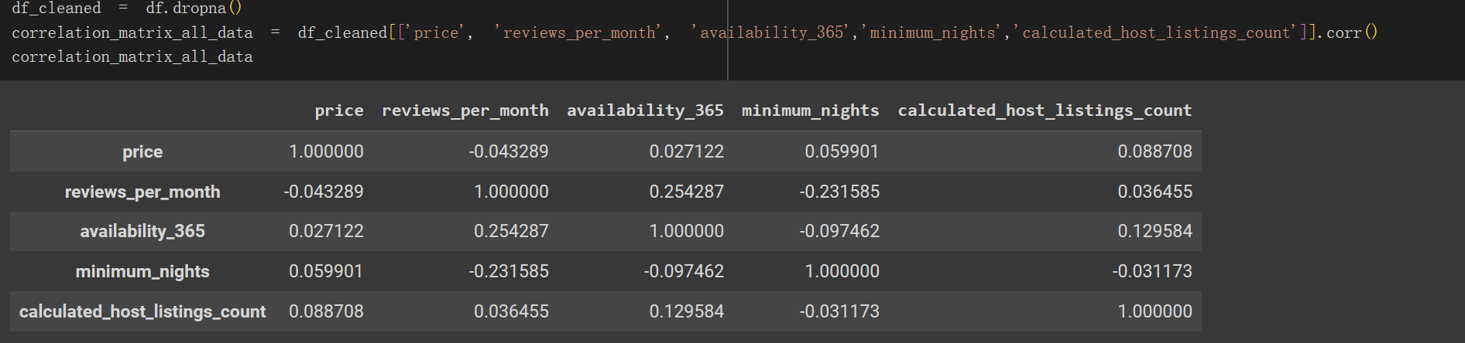
Groupby Neighborhood box plot
Price distribution across neighborhood groups using box plots.
Displayed the number of listings in each neighborhood group using count plots.
Plotted bar graphs showing the median price in each neighborhood group.
correlation relationships between 'price', 'reviews_per_month', 'calculated_host_listings_count', 'availability_365', and 'minimum_nights'.

Slide 18
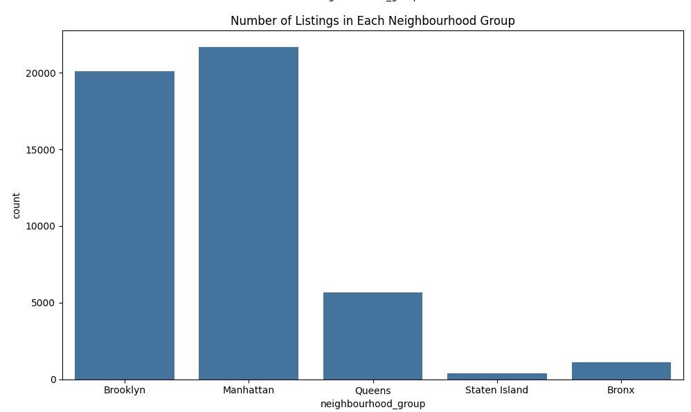
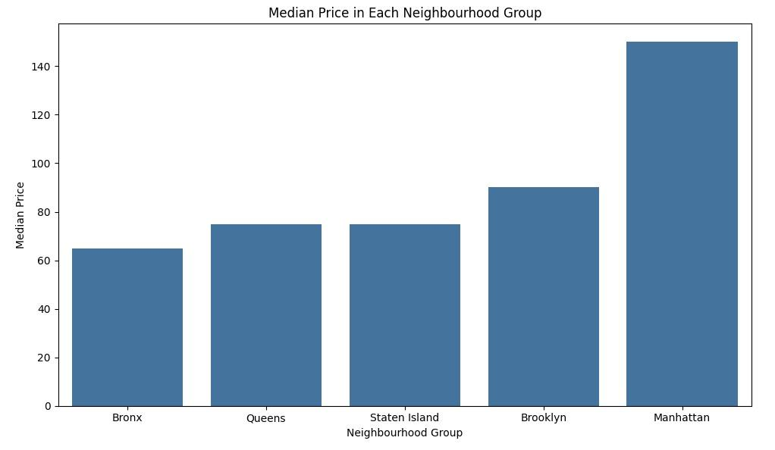
Median Price + Housing
Numbers
From the Number of Housing：
Manhattan & Brooklyn have the most housing availability and listing at NYC
Queens, Bronx & Staten Island are less
From the Median Price:
Manhattan has the Highest Median Price
The other parts (Bronx, Queens, Staten Island & Brooklyn) are mostly the same

Slide 19
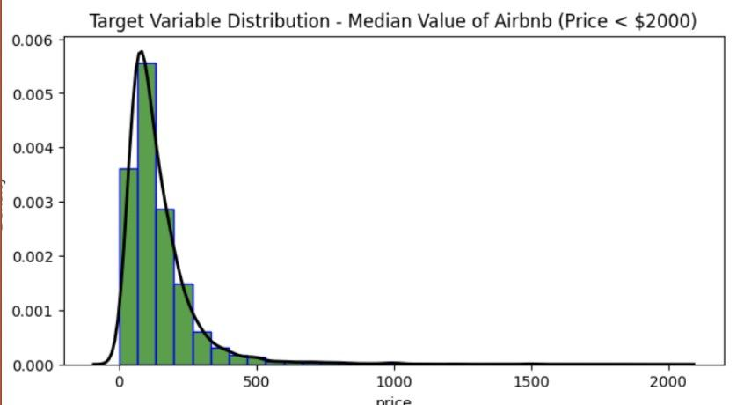
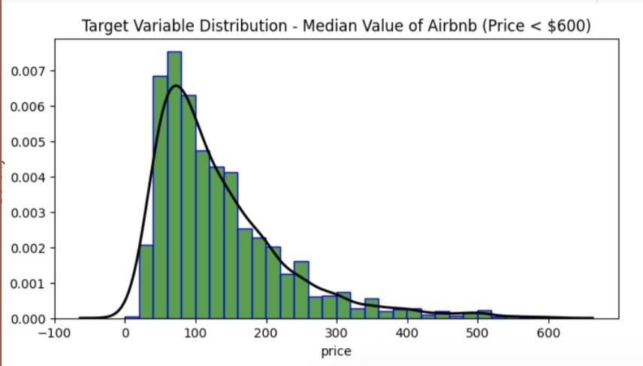
Median Value of Airbnb
Target Variable Distribution:
Visualized the distribution of the target variable 'price' using histograms with Kernel Density Estimation (KDE).
Plotted histograms and KDE plots for the entire dataset and subsets filtered for prices less than $600
The Median Value of NYC will be at the range (0<x<200)

Slide 20
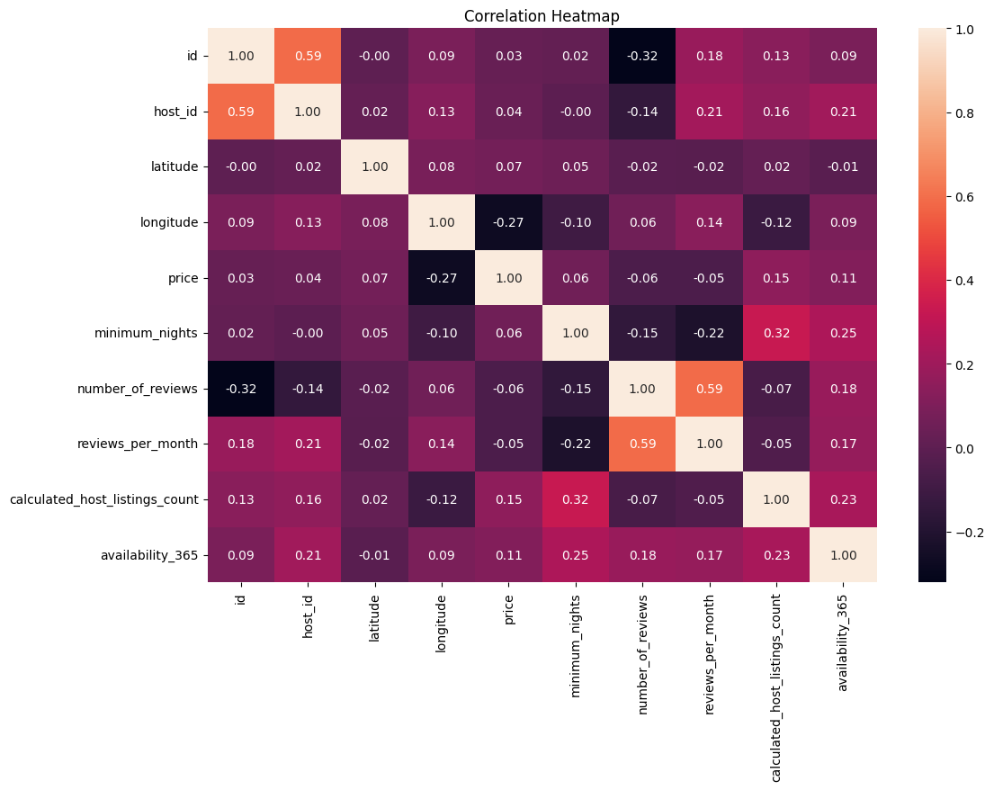
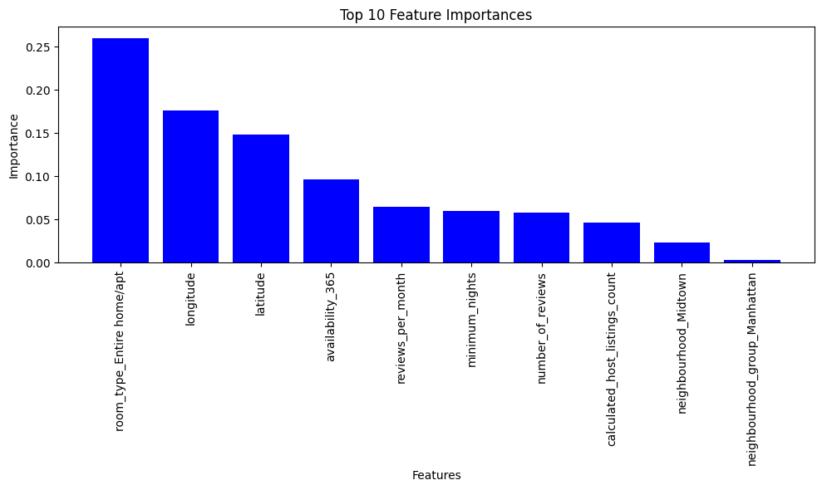
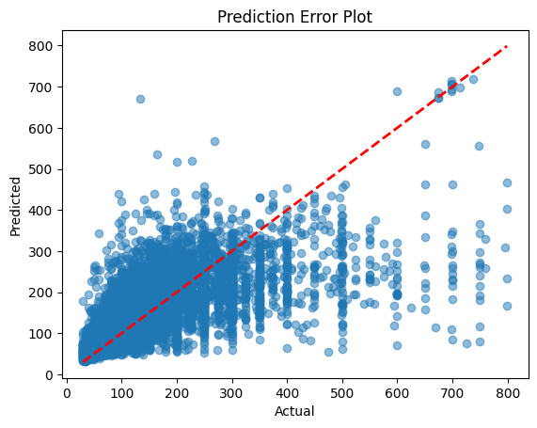
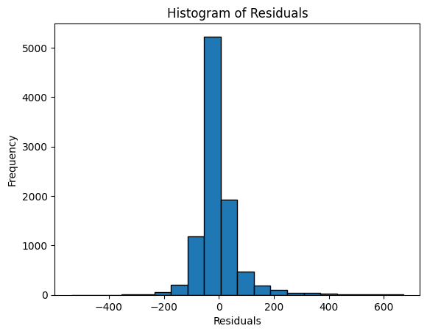
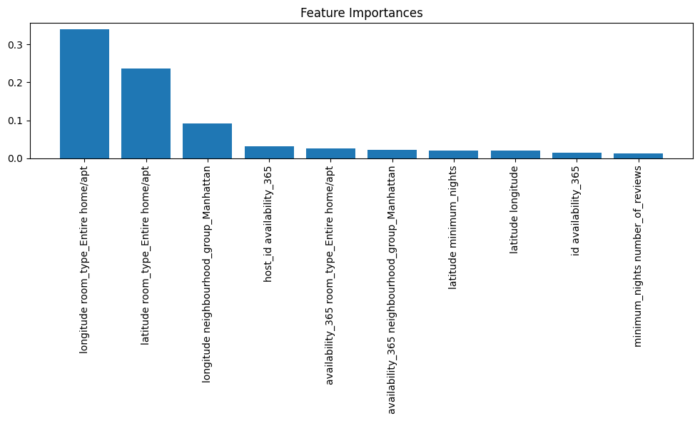
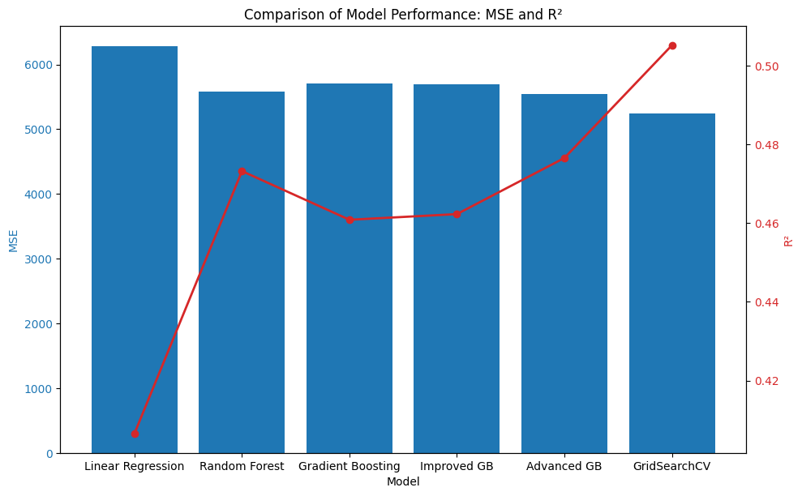
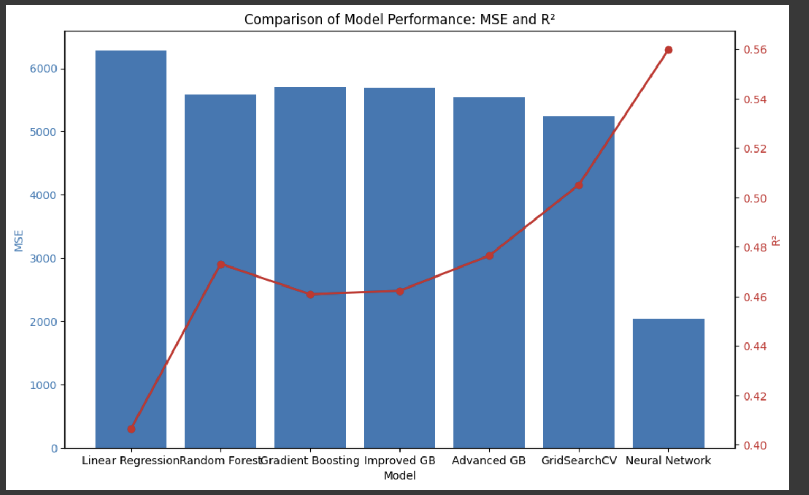
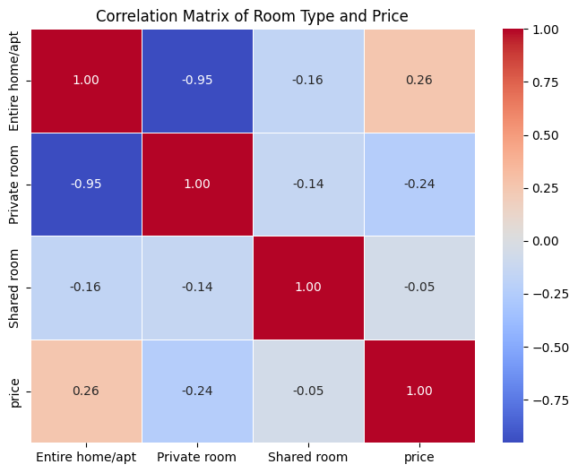
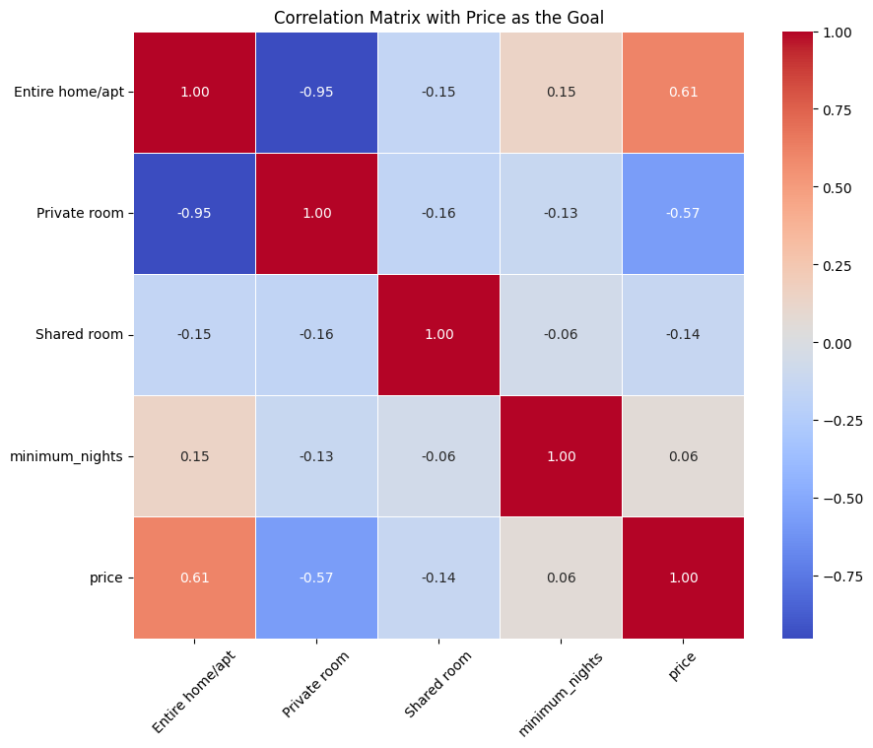
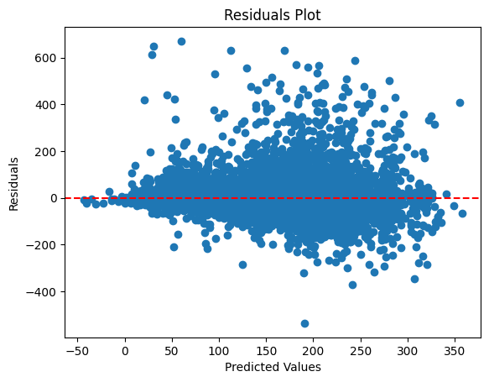
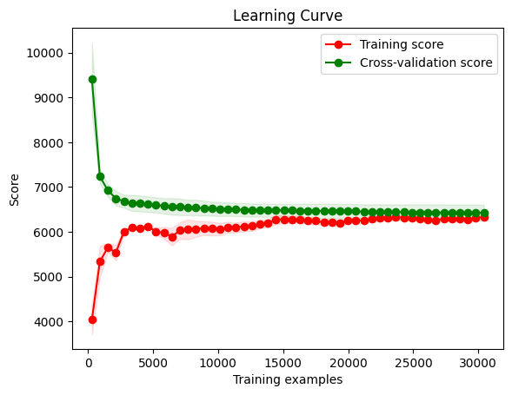
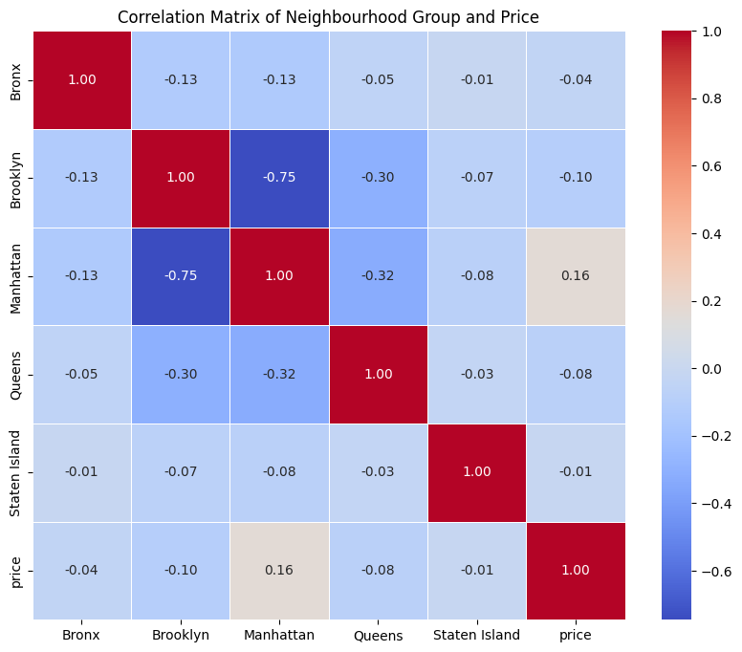
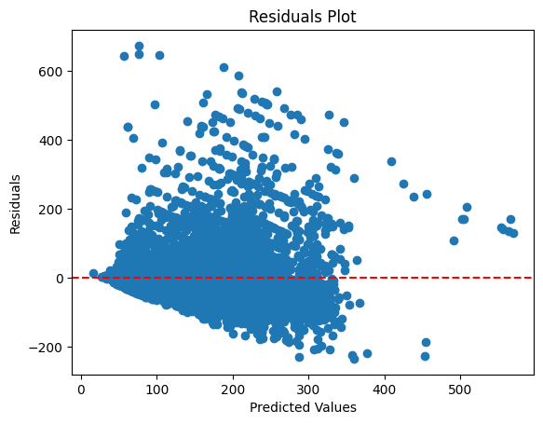
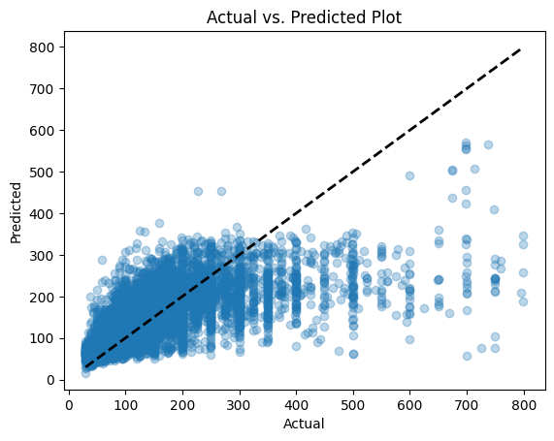

Slide 21
Data Transformation
Data Transformation:
Created the list named room_type containing the possible values for the 'room_type' column: 'Entire home/apt', 'Private room', and 'Shared room'.
Encoding to Dummy Variables:
Room type and neighborhood group are both strings, and they both have to be dummy variables before you can see how they relate to price.
Used pd.get_dummies() function to encode the 'room_type' column into dummy variables.
Specified the columns parameter as ['room_type'] to indicate the column to be encoded.
Set the dummy_na parameter to False to avoid creating dummy variables for any potential missing values.
Assigned the resulting DataFrame to df_encoded.
Output Display:
Printed the DataFrame df_encoded to show the encoded representation of the 'room_type' column using dummy variables.

Slide 23
Correlations

Slide 24
Notes:
Reviews and Reviews per Month: There is a strong positive correlation (0.59) between number_of_reviews and reviews_per_month, which is intuitive as more frequent reviews per month would naturally increase the total number of reviews.
Minimum Nights and Price: minimum_nights and price show a small negative correlation (-0.27), indicating that listings requiring longer stays might be priced slightly lower, perhaps to attract longer-term bookings.
Availability and Calculated Host Listings Count: availability_365 shows a positive correlation with calculated_host_listings_count (0.23), indicating that hosts with more listings tend to offer greater availability throughout the year.
Usefulness:
This heatmap is particularly useful for:
Feature Selection: Identifying highly correlated variables that might need to be removed or adjusted to prevent multicollinearity in linear models.
Insight Generation: Understanding relationships between variables which can help in hypothesizing about causal relationships, though correlation does not imply causation.
Interpretation for Modeling:
If you are using models that assume little to no multicollinearity, such as linear regression, you might consider dropping or combining features that are highly correlated.
For other models like tree-based models, multicollinearity is less of an issue, but understanding which features are related can still help in interpreting model behavior and results.

Slide 25
05
Model Selection

Slide 26
Features Used:
neighbourhood_group, neighbourhood, room_type: Categorical features that categorize the listings. These are key determinants of pricing dynamics in the rental market.
latitude, longitude: Location coordinates that capture the geographical nuances of pricing.
minimum_nights, number_of_reviews, reviews_per_month, availability_365, calculated_host_listings_count: Numeric features that describe the listing’s popularity, demand, and operational metrics which can influence price.

Slide 27
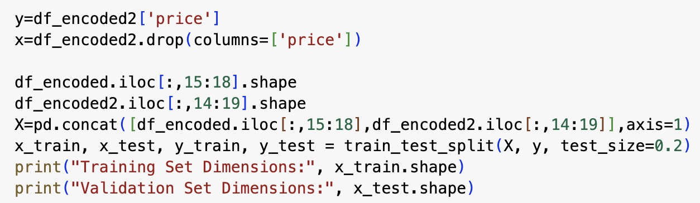
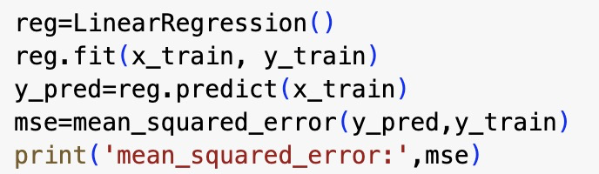
Linear Regression only for neighbourhood_group and room_type
mean_squared_error: 7177.255675589521
need to update and change our model
—-------- >

Slide 28
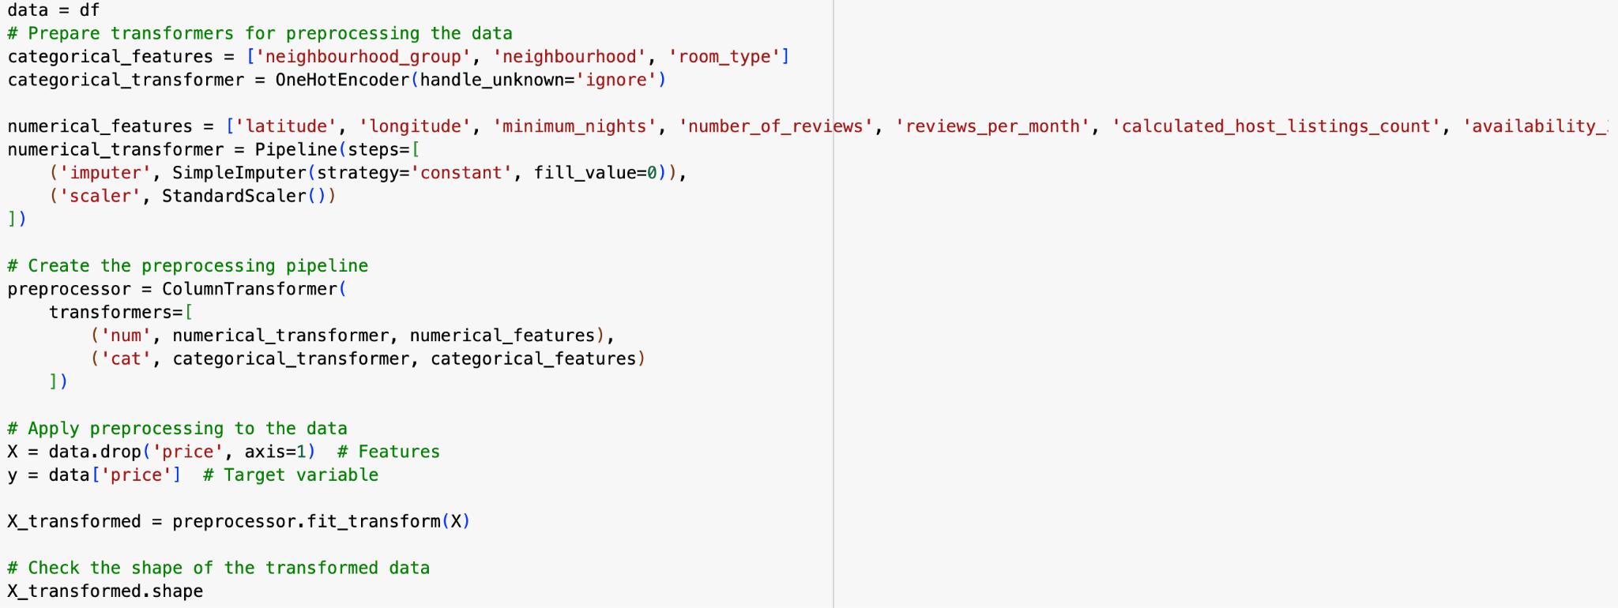
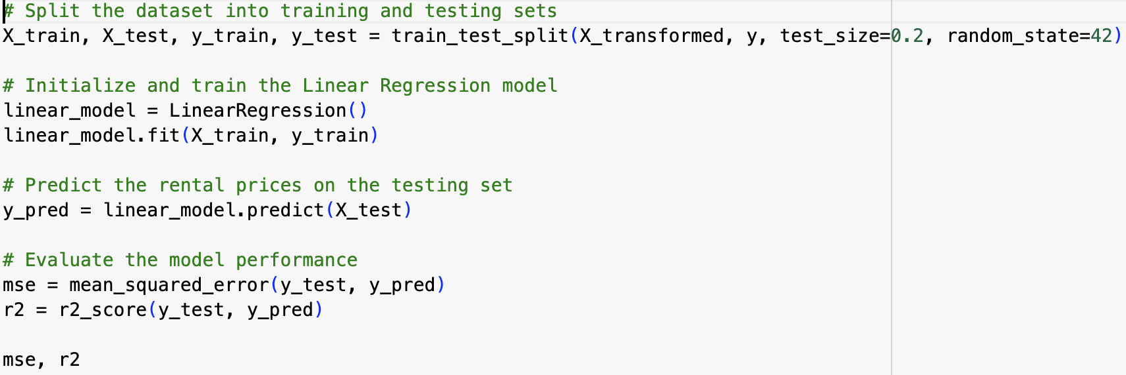
Linear Regression for all features
MSE: 6281.556536958027
R^2: 0.406597060546814

Slide 29
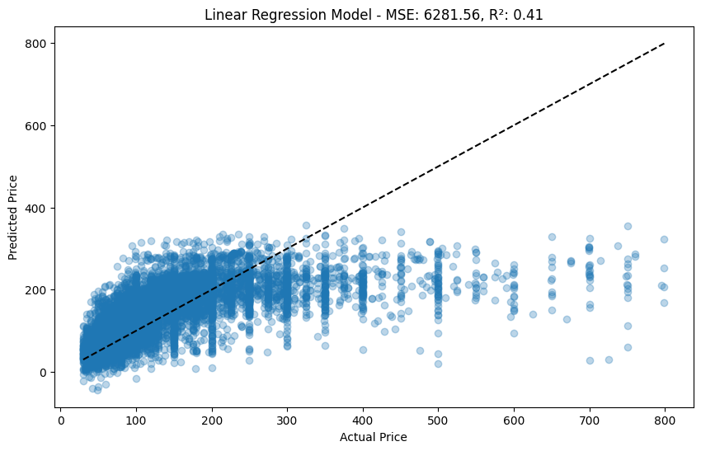
Linear Regression Accuracy

Slide 30
Random Forest
Random Forest: R² = 0.47, MSE = 5,576
Notes:
coefficient

Slide 31
Notes:
neither over fitting or under fitting

Slide 33
Gradient Boosting Regressor
R² = 0.46, MSE = 5,707

Slide 35
GridSearchCV
R² = 0.51, MSE = 5,238
Best parameters: {'regressor__learning_rate': 0.1, 'regressor__max_depth': 5, 'regressor__max_features': 'sqrt', 'regressor__n_estimators': 200, 'regressor__subsample': 0.9}
Improved MSE: 5238.639461032996, Improved R²: 0.5051188289681703

Slide 36
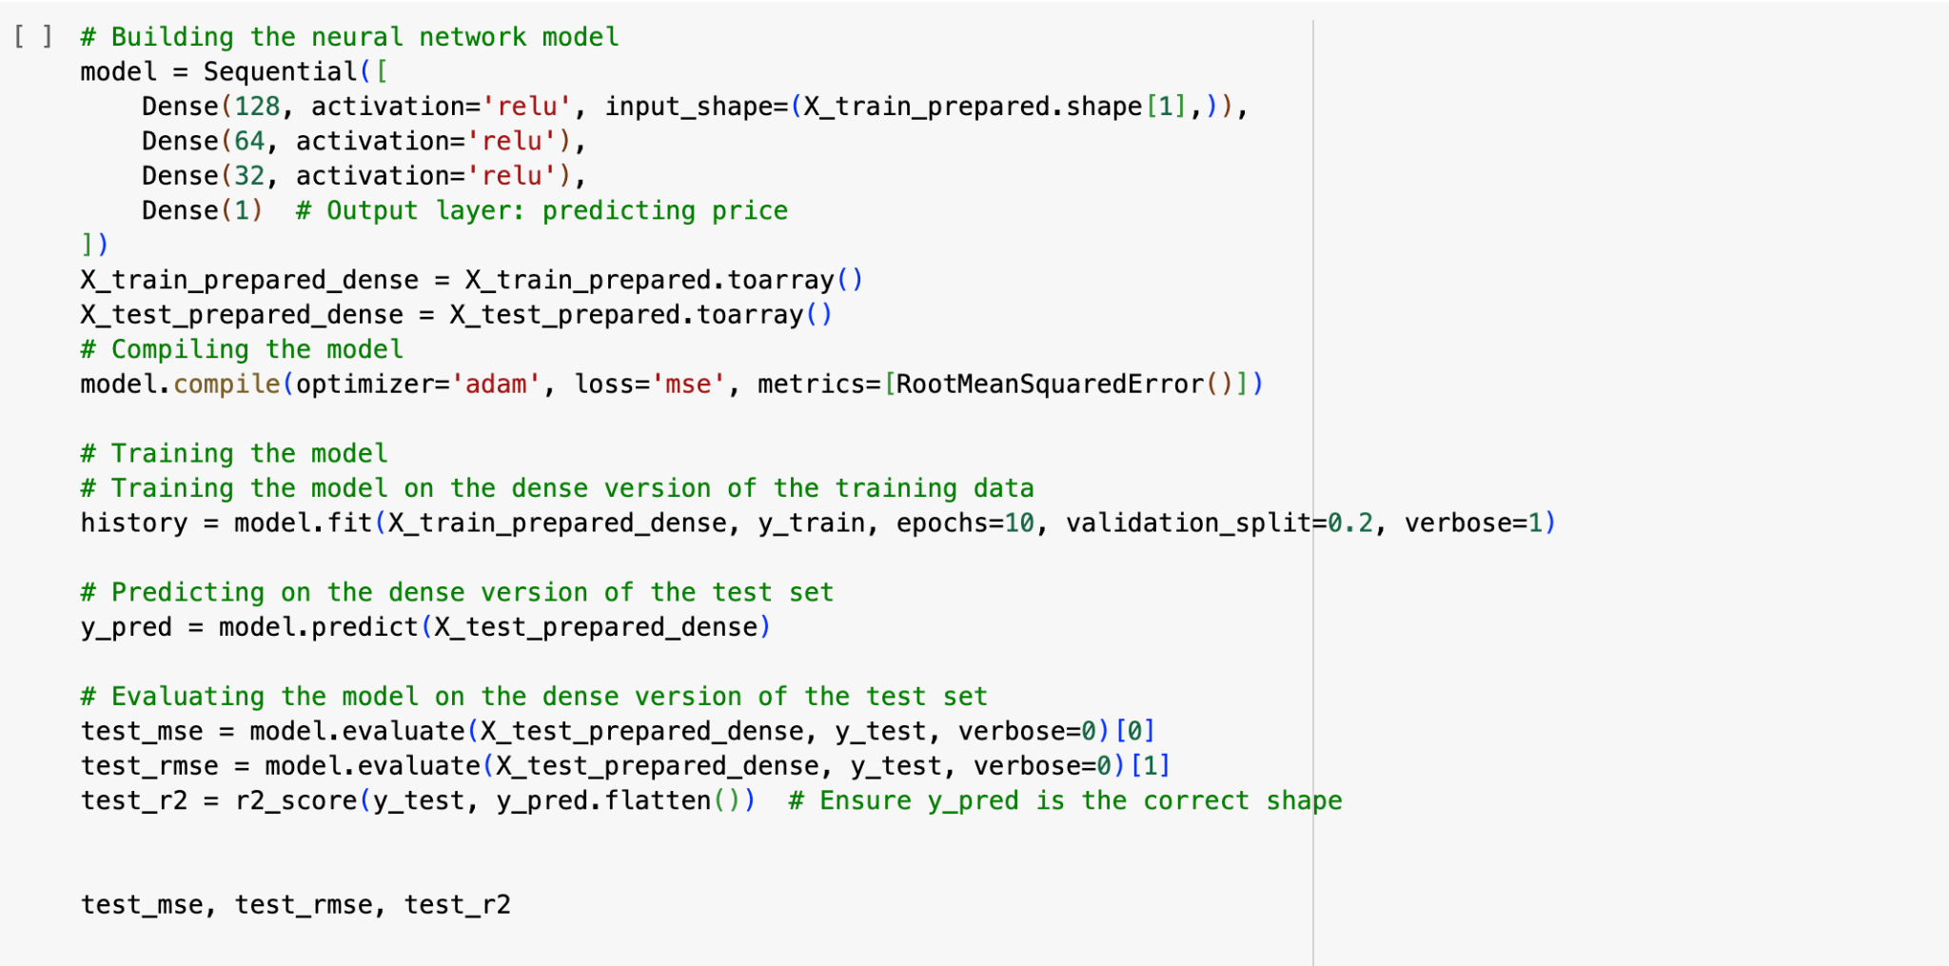
Deep Learning Model: R² = 0.559, MSE = 2040
Deep Learning

Slide 37
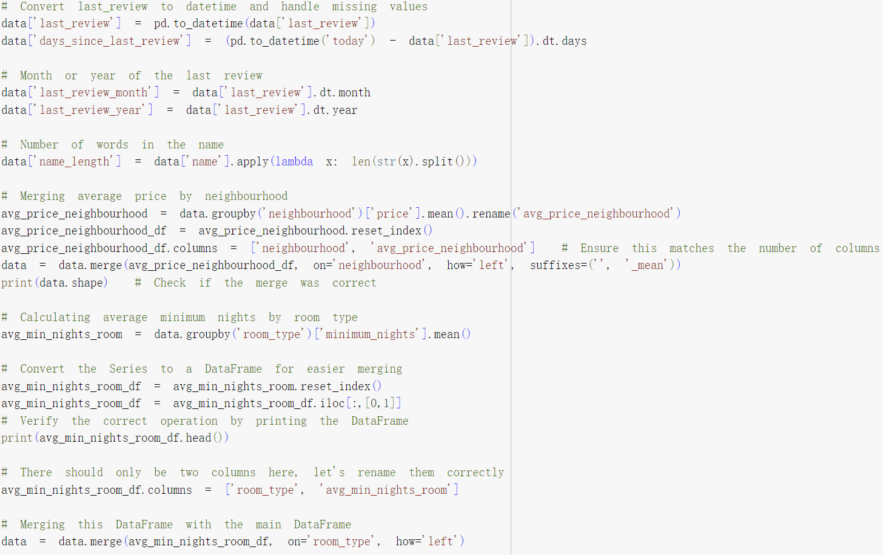
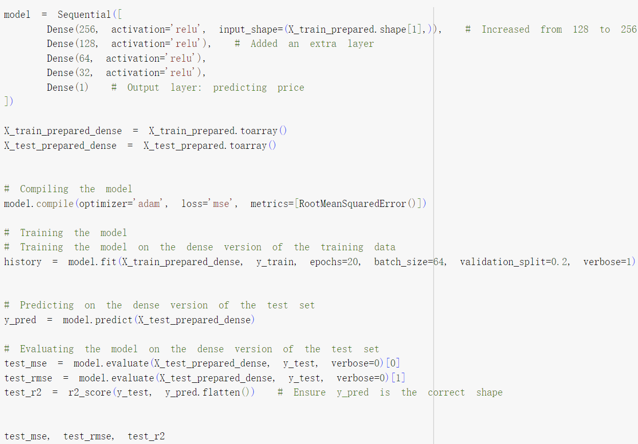
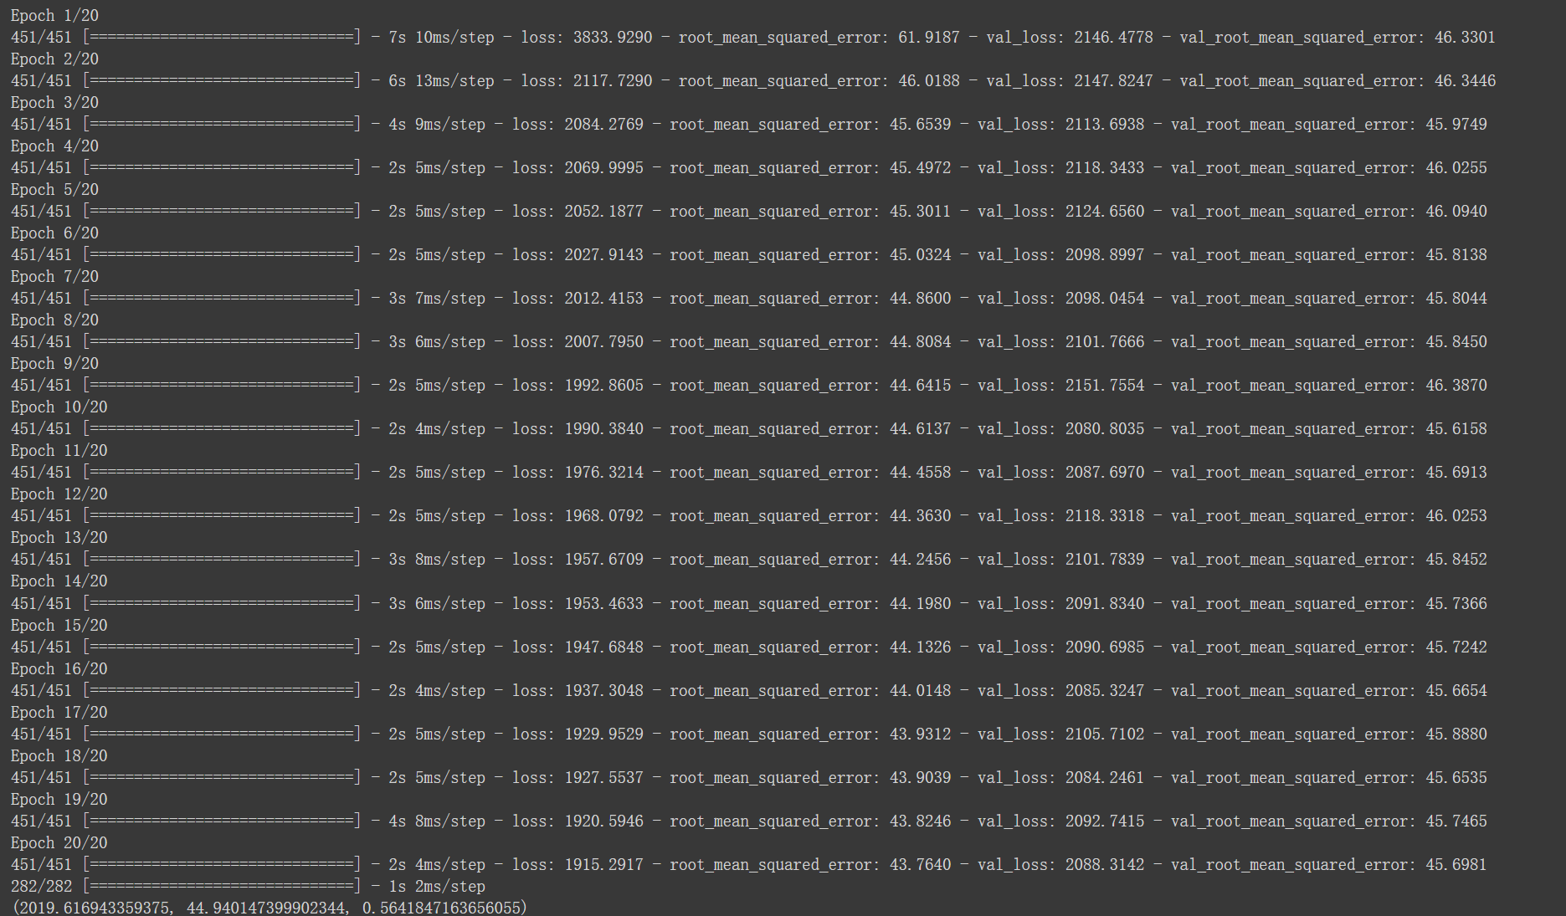
Deep Learning Model: R² = 0.564, MSE = 2019
Deep Learning

Slide 38
06
Conclusion & Limitation

Slide 39
Results & Discussion
Overview of Model Performance
Linear Regression: R² = 0.40, MSE = 6,281
Random Forest: R² = 0.47, MSE = 5,576
Gradient Boosting: Initial R² = 0.46, MSE = 5,707
Improved Gradient Boosting with Hyperparameter Tuning: R² = 0.46, MSE = 5,692
Advanced Gradient Boosting with Feature Engineering: R² = 0.48, MSE = 5,541
GridSearchCV: R² = 0.51, MSE = 5,238
Deep Learning Model: R² = 0.564, MSE = 2019

Slide 40
Overfitting vs. Underfitting:
Overfitting: If any model had a considerably higher performance on training data compared to test data, it might be overfitting.
Underfitting: Conversely, if models are too simple to capture the data complexity, they might underfit, leading to low R² values across both training and testing phases.
Model Assumptions: For instance, linear regression assumes a linear relationship between features and the target variable. If this assumption doesn't hold (which is common in real-world data), the model will likely underperform.

Slide 41
Discussion on Low R² Value
Complexity of the Dataset: The dataset might have a high level of inherent variability that simple or even complex models struggle to capture fully. Features in the dataset may not provide enough information to predict outcomes accurately.
Quality and Quantity of Data: If the data has issues like missing values, insufficient records, or noisy data, models may not learn effectively.
Feature Relevance: The features used may not have a strong predictive relationship with the target variable. This can be a limitation if the dataset lacks fields that are significant predictors of the outcome.

Slide 42
Limitation of this Project
Model Limitations:
Linear regression:
- Sensitive to outliers.
- Assumes a linear relationship between features and targets, which may not always hold.

Slide 43

Compare & Analysis
Compare and analyze:
- PERFORMANCE: The gradient boosted regression tree outperforms linear regression on all metrics, showing lower MAE and RMSE, and higher R² values.
- Model Complexity: Gradient boosted regression trees are more complex than linear regression, requiring more computational resources and time for training and tuning.
- Interpretability: Linear regression models are usually easier to interpret because they provide direct coefficients to describe the relationship between features and targets. Gradient boosted regression trees, on the other hand, are more difficult to interpret because they are integrated models based on a large number of decision trees.

Slide 44

Potential Areas of Improvement
Improve the Feature Engineering
Creating more meaningful features from existing dataset
Obtaining additional data from other resources
Increased Data Collection:
collect more comprehensive or higher-quality data that could improve the model’s learning capability.
Experimentation with Non-linear Models:
Since traditional models have limitations, experimenting with non-linear models or neural networks might yield better results.
Notes:
Improvement Strategies
Feature Engineering: Potential for creating more meaningful features from the existing data, or obtaining additional data that could help improve model accuracy.
Advanced Modeling Techniques: Consider whether more sophisticated models or ensemble methods might capture the complexity of the data better.
Increased Data Collection: Suggest ways to collect more comprehensive or higher-quality data that could enhance the model’s learning capability.
Experimentation with Non-linear Models: Since traditional models have limitations, experimenting with non-linear models or neural networks might yield better results.

Slide 45

Next Step：Future
We will consider to improve our accurate rate at the summer
Edit base on peer & professor‘s recommendation

Slide 46
Improvement Strategies
Feature Engineering: Potential for creating more meaningful features from the existing data, or obtaining additional data that could help improve model accuracy.
Advanced Modeling Techniques: Consider whether more sophisticated models or ensemble methods might capture the complexity of the data better.
Increased Data Collection: Suggest ways to collect more comprehensive or higher-quality data that could enhance the model’s learning capability.
Experimentation with Non-linear Models: Since traditional models have limitations, experimenting with non-linear models or neural networks might yield better results.

Slide 47
Aydin, Rebecca. “How 3 Guys Turned Renting Air Mattresses in Their Apartment into a $31 Billion Company, Airbnb.” Business Insider, www.businessinsider.com/how-airbnb-was-founded-a-visual-history-2016-2. Accessed 30 Mar. 2024.
Works Cited

